Slide 1

FINAL PROJECT ON FRIENDBOOK CHANDRA SEKHAR YELLAPU (1016356770) PUNNA YASHWANTH KUMAR (1016238420)

Slide 2
SOFTWARE REQUIREMENTS:
PHP My Admin as DataBase.
Used draw.io for ER Diagr
XAMPP Server for Apache

Slide 3
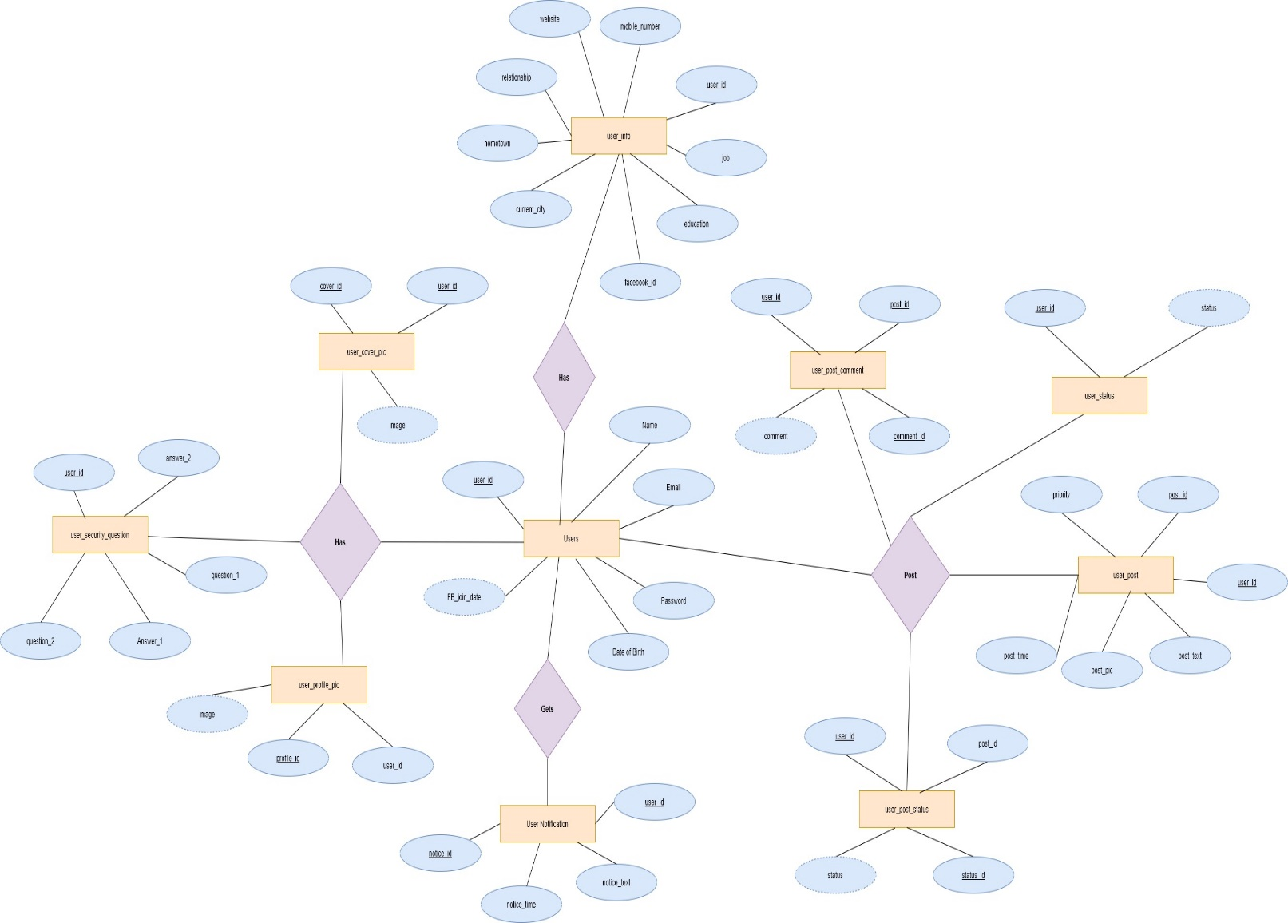
ER DIAGRAM

Slide 4
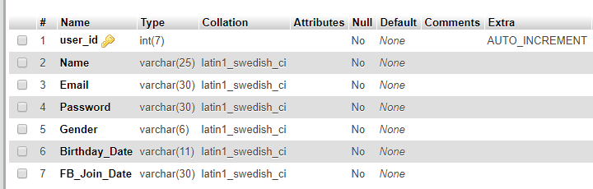
DATABASE INSTANCE
User Instance:

Slide 5
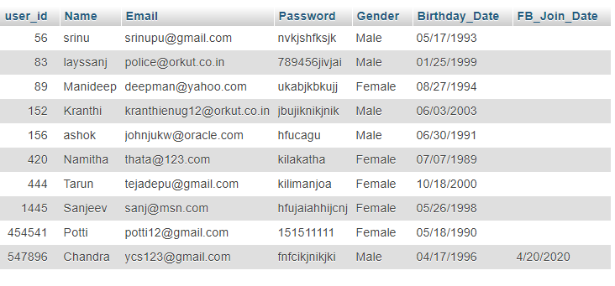

Slide 6
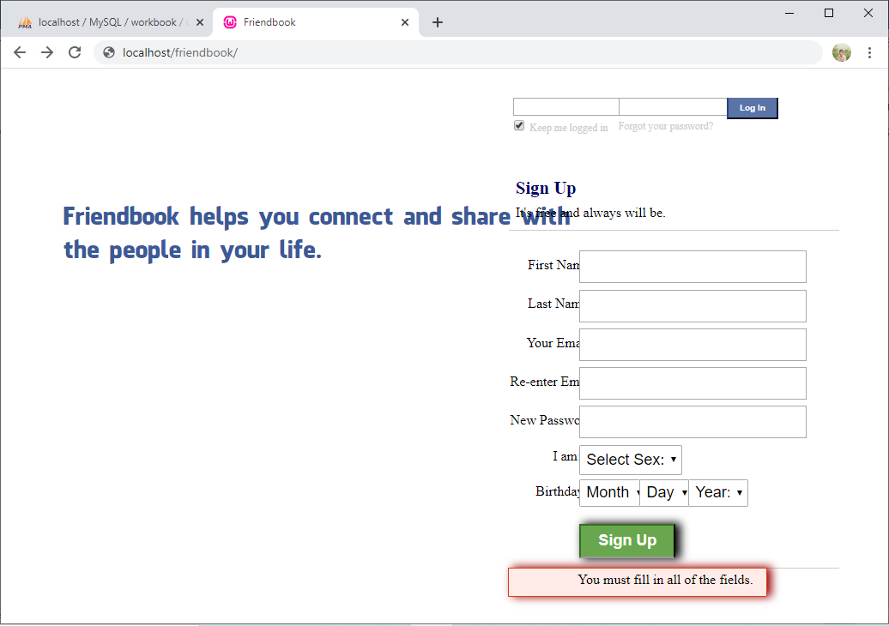
WEB INTERFACE
Login Page

Slide 7
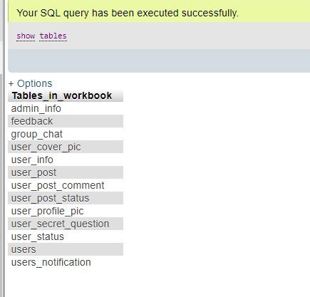
QUERIES
SQL Query:
show tables
Query Result:
Display the tables created in the Database

Slide 8
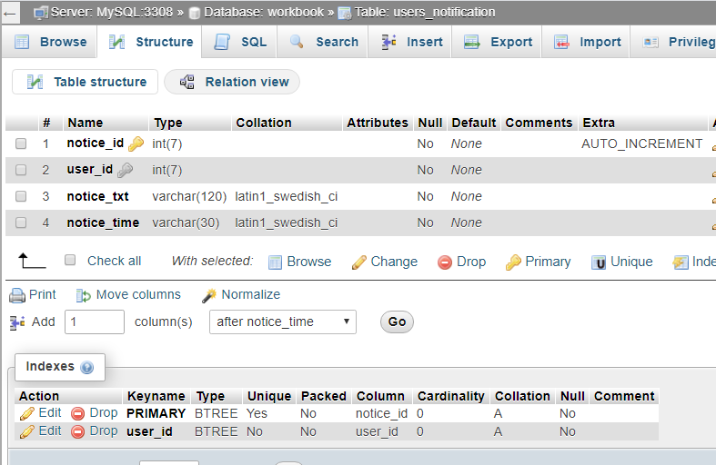
SQL Query: Create Table with set of column names and type of data and size of it includes if any primary or foreign keys
CREATE TABLE `users_notification` (
`notification_id` int(7) NOT NULL AUTO_INCREMENT,
`user_id` int(7) NOT NULL,
`notification_txt` varchar(120) NOT NULL,
`notification_time` varchar(30) NOT NULL,
PRIMARY KEY (`notification_id`),
KEY `user_id` (`user_id`)
)
Query Result:

Slide 9
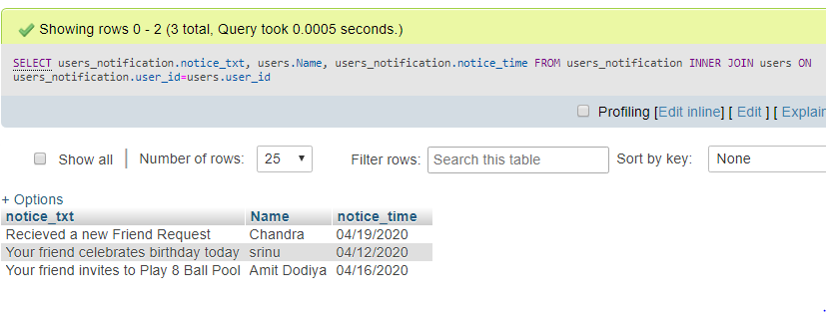
SQL Query: View the notifications for the particular user
SELECT users_notification.notice_txt, users.Name, users_notification.notice_time
FROM users_notification
INNER JOIN users ON users_notification.user_id=users.user_id;
Query Result:

Slide 10
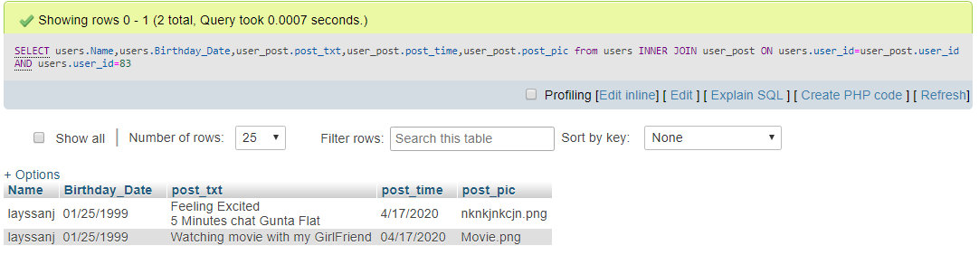
SQL Query: Display the posts made by the user on one’s Own Profile
SELECT users.Name,user_post.post_txt,user_post.post_time,user_post.post_pic
from users INNER JOIN user_post
ON users.user_id=user_post.user_id AND users.user_id=83
Query Result:

Slide 11
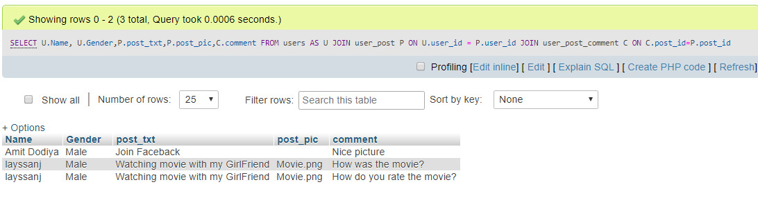
SQL Query: List the comments made on the posts
SELECT U.Name, U.Gender,P.post_txt,P.post_pic,C.comment
FROM users AS U
JOIN user_post P
ON U.user_id = P.user_id JOIN user_post_comment C
ON C.post_id=P.post_id;
Query Result:

Slide 12
THANK YOU CHANDRA SEKHAR YELLAPU (1016356770) PUNNA YASHWANTH KUMAR (1016238420)

